Slide 1

Understanding SDLC
The Software Development Life Cycle (SDLC) is a process used by the software industry to design, develop, and test high-quality software applications. It involves a series of distinct phases and activities, each with its own unique purpose and characteristics.

Slide 2
"SDLC is the process used in software project management to plan, design, develop, test, and deploy a software application, ensuring a high-quality product.
The Importance of SDLC
1
Quality Assurance
2
Risk Reduction
3
Effective Communication
SDLC ensures that the software meets high standards of quality and reliability through rigorous testing and validation.
By defining clear requirements and specifications early on, SDLC helps minimize the risk of project failure or budget overruns.
SDLC promotes clear communication and collaboration among team members, leading to better coordination and understanding.

Slide 3
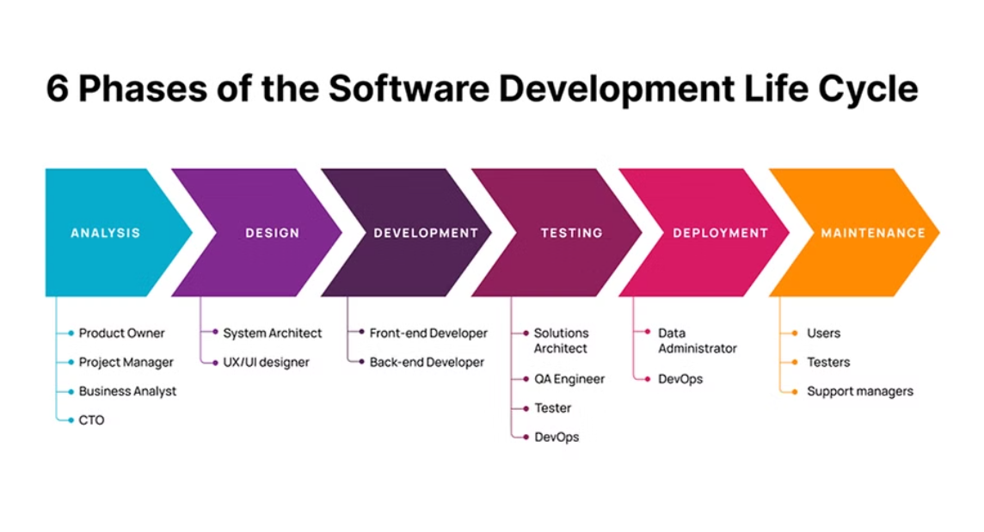
Phases of SDLC
Requirements Gathering
System Design
Implementation
Understanding and documenting the needs of the end-users, stakeholders, and system requirements.
Developing a high-level and detailed design of the software based on the gathered requirements.
Converting design specifications into software by writing code, integrating different components, and conducting initial testing.

Slide 4

Requirements Gathering
1
Stakeholder Involvement
2
User Research
Engaging with end-users, customers, and other stakeholders to understand their needs and expectations.
Conducting interviews, surveys, and data analysis to gather detailed insights into user requirements and preferences.

Slide 5




System Design
Architectural Planning
Defining the overall structure of the software, including its modules, interfaces, and interactions.
Technology Selection
Choosing the appropriate technology stack and tools based on the project's requirements and constraints.
Detailed Documentation
Creating detailed design documents and diagrams that serve as a blueprint for the development team.

Slide 6

Implementation
1
Coding
Writing and testing code for individual components and integrating them into a working system.
2
Integration
Bringing all the individual components together and testing for seamless operation and functionality.
3
Initial Testing
Conducting initial rounds of testing to ensure that the implemented features meet the defined requirements.

Slide 7
Testing and Quality Assurance
Unit Testing
Verifies the smallest parts of the software: individual functions or modules.
Integration Testing
Ensures the interactions between different modules work as intended when combined.
System Testing
Validates the fully integrated and tested software against the specified requirements.

Slide 8

Deployment
Server Configuration
Version Control
Release Planning
Setting up the necessary infrastructure and resources for hosting the software application.
Implementing effective version control mechanisms to manage updates and changes to the software.
Carefully planning and executing the release process to ensure a smooth and successful deployment.

Slide 9
Operation & Maintenance
24/7
99%
Continuous Improvement
Support Availability
Uptime Guarantee
Software Enhancements
Round-the-clock support services to address any issues and ensure uninterrupted operation.
Ensuring a 99% uptime guarantee, minimizing disruptions and downtime for users.
Regular updates and enhancements to keep the software relevant and competitive in the market.

